Slide 1
FINTECH – A – THON
Title: AI-Powered Fraud Detection for UPI Transactions
TEAM NAME : NECIANS
TEAM NO : 41
TEAM MEMBERS :
ARUN GOPAL
PULAN NARESH KUMAR SARFRAJ AHAMED SIVA SANKAR

Slide 2
Problem Statement:
Financial institutions struggle to detect and prevent fraudulent transactions.
Fraud leads to significant financial losses and reputational risks.
Need for an AI/ML-driven approach to analyze transaction patterns and user behaviors to flag suspicious activities. digital payment platforms

Slide 3
Technology Stack:
•Programming Language: Python
•Libraries & Frameworks: TensorFlow, XG Boost, Scikit-learn, Pandas, NumPy
•Machine Learning Models Used:
•XG Boost Classifier
•LSTM with Attention Mechanism
•Ensemble Model
•Preprocessing Techniques:
•Data normalization, label encoding, feature selection, SMOTE for handling class imbalance.

Slide 4
Code & Implementation:
•Data Preprocessing:
•Loading JSON dataset, handling missing values, removing duplicates.
•Feature selection based on correlation analysis.
•Model Training:
•XG Boost with hyperparameter tuning.
•LSTM model with bidirectional layers and self-attention mechanism.
•Meta model (Logistic Regression) for ensemble learning.
•Performance Metrics:
•Micro & Macro F1-Score, Precision, Recall.
Model evaluation using classification reports.

Slide 5
Evidence:
UPI fraud is rising due to phishing, fake links, and unauthorized transactions. Fraudsters manipulate metadata, use device spoofing, and exploit behavioral patterns to evade detection. Traditional rule-based systems fail to adapt, requiring machine learning for real-time fraud detection.
Fraud cases are rare, making model training challenging due to class imbalance. Techniques like SMOTE and ensemble learning improve detection. Key fraud indicators include abnormal transaction frequencies, high-risk geolocations, and unusual payment patterns.
A hybrid approach using LSTM and XG Boost enhances accuracy. LSTMs capture sequential behavior, while XG Boost classifies static features. An ensemble model with a meta-learner boosts fraud detection, measured by accuracy, precision, recall, and F1-score.

Slide 6
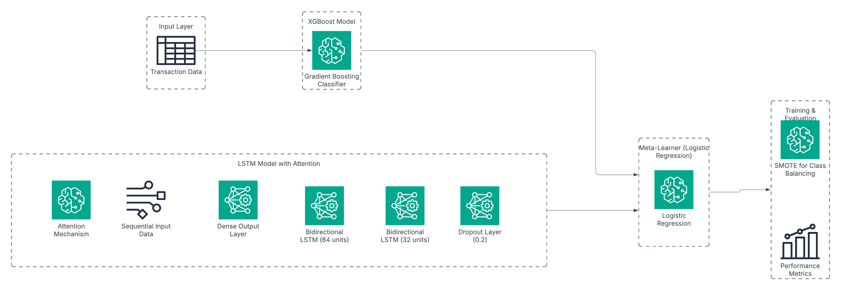
Model Architecture

Slide 7
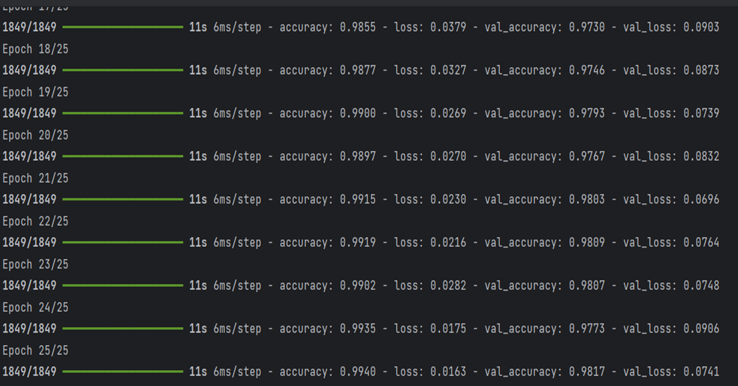
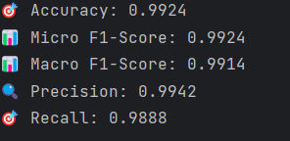
Demo:
Model Training Model Evaluation

Slide 8
GitHub Link:
https://github.com/Arungopal1/npci_hackathon.git
Conclusion:
•Our AI-powered fraud detection system significantly enhances security in UPI transactions.
•By combining multiple models, it improves accuracy and reduces false positives.
•The system adapts to evolving fraud patterns using machine learning.

